Slide 1
ADTA 5240 FINAL PROJECT
TOP 10 US BANKS PERFORMANCE
2015-2023
PRECOVID,COVID,POST-COVID PERIODS
Aeshala Rudra Tapaswi 11686609
Zakiya Al Jabri 11727401
Ezeanyagu Ifeanyichukwu 11616966
Harsha Vardhan Chavvakula 11646088
Aditya Keshavapatnam 11705737

Slide 2
Overview
In this project, we are working on the Top 10 US banks’ stock data which we acquired from Yahoo Finance. We will perform EDA on the dataset and determine the attributes required for analyzing the performance of the banks during the three time periods i.e. Pre COVID, During-COVID, and Post COVID. Load the data into the Google Cloud storage.
Project Objectives
Collect, preprocess, store, and retrieve the data.
Phases in Data Lifecycle
Generation
Collection
Processing
Storage
Management
Analysis
Visualization
Interpretation

Slide 3
Technologies Used
Python stands out as a versatile and widely adopted programming language, offering a robust ecosystem of libraries and tools tailored for data exploration and manipulation. Hence we performed our EDA on the Dataset using Python to gain insights into the data that we have.
GCP is one of the top three cloud service providers. The integration of GCP services ensures a streamlined and scalable approach to data preparation, enabling data scientists to focus on extracting meaningful insights from their datasets without the burden of infrastructure management.
Open Refine is a widely used open-source tool for exploring, cleaning, and transforming data.
Hadoop Ecosystem
Big Query helps in isolating the storage options from the computation engine that analyses data, Big Query optimizes flexibility. Big Query can be used to evaluate your data wherever it is or to store and analyze your data.
As a data warehousing system, Apache Hive can do large data analysis. We can use SQL to read, write, and manage huge sets of data.
The objective of Spark was to develop a new framework that maintained the fault tolerance and scalability of Hadoop Map Reduce, but was tailored for quick iterative processing such as machine learning and interactive data analysis.
Why these Technologies
The programming language we used in this project for exploratory data analysis (EDA) is Python. It has many libraries like Matplotlib, NumPy, and Pandas, which are strong tools for data analysis and visualization. We used Python and Open Refine to analyze and clean the dataset. GCP is a cloud computing platform that provides a wide range of services, including machine learning, computation, storage, and more. It has a user-friendly interface. The smooth integration of services offered by GCP makes it simple for customers to create, launch, and maintain applications. Hadoop is a reliable file distribution method for big data. For file distribution, we used Hadoop, a highly used open-source.

Slide 4
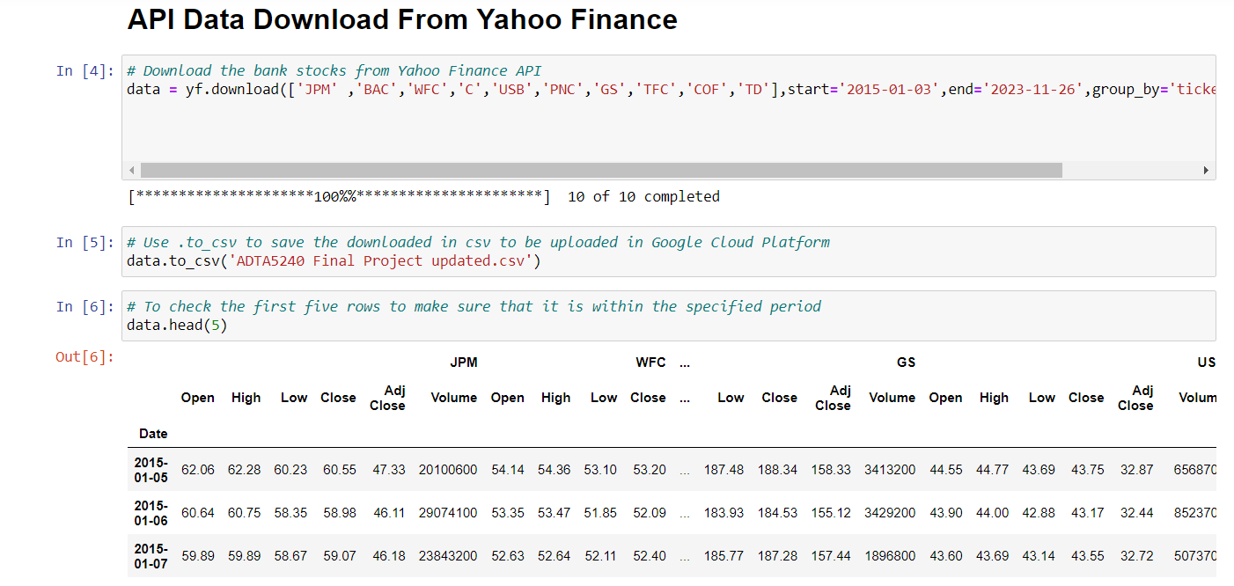
DATA GENERATION
First, we import Python libraries NumPy and Pandas. Then we download the data using Python and Yahoo Finance API. Then we save the data in comma-separated value(CSV) format to upload it to the Google Cloud platform. Then we check the first five rows to verify that the period is as per our required specifications.

Slide 5
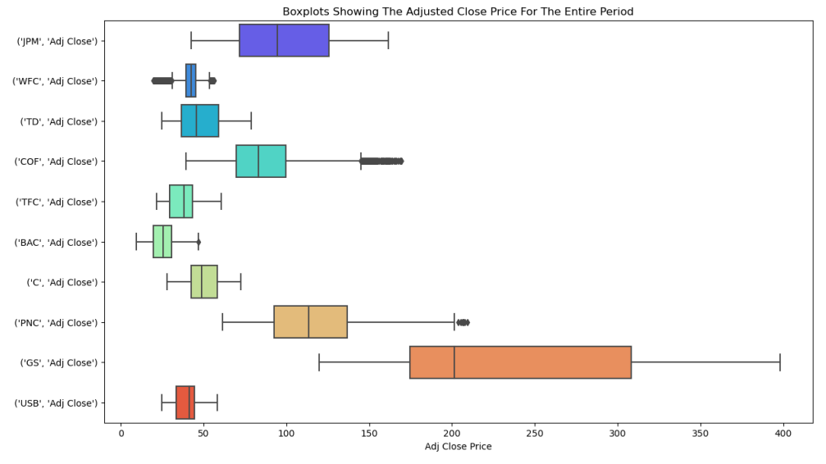
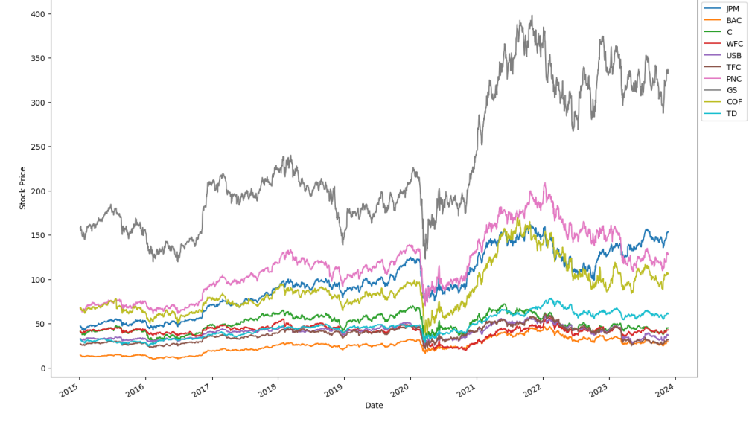
Exploratory Data Analysis
The Line chart graph tells us the fluctuations in the stock performances of the top 10 US banks.
In the box plot, we see that there are a few banks with potential outliers. But we shouldn’t consider them as outliers because, in the stock analysis, these are just the price fluctuations or the stock volatility of these banks. These can be the highs and lows of the banks.
Adjusted close stock price for the entire period from Jan 5, 2015 to Nov 24, 2023

Slide 6
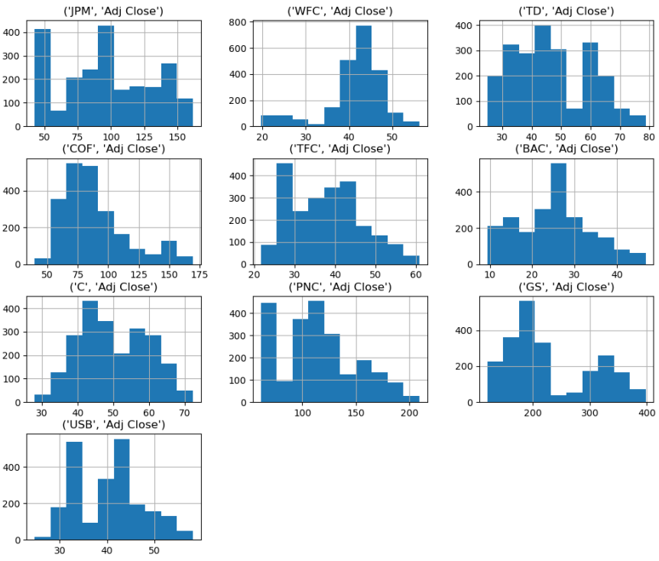
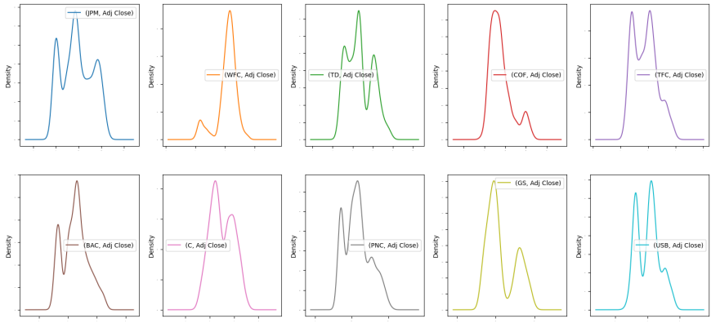
Exploratory Data Analysis
By examining the histograms, we evaluate the frequency and size of stock price movements and fully understand the variability & stability of these ten banks. We can see and identify any trends, abnormalities, and commonalities between the banks. We see the rise and fall of stock values over time.
We employed density plots for each of the top 10 banks' stock prices to provide an extensive picture of the distribution and concentration of stock values within each bank. We hope to find patterns and trends that could influence banks' financial judgement. These density charts show a clear and comprehensive overview of the financial ecosystem.

Slide 7
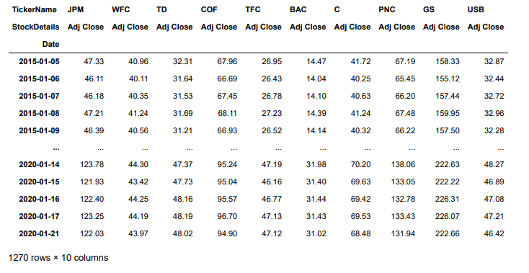
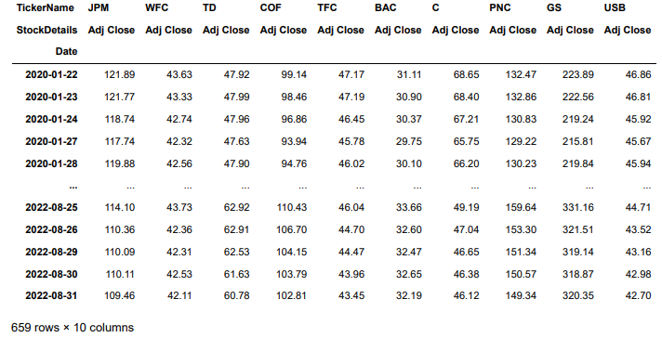
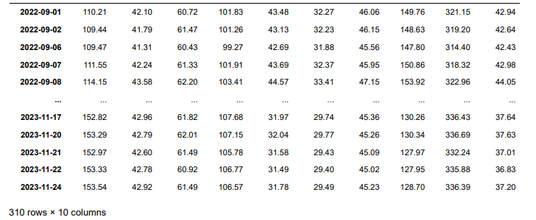
Exploratory Data Analysis
We have dropped the unnecessary attributes and split the dataset into 3 parts i.e. pre-covid, covid and post-covid.
The time periods for the above 3 partitions are as follows.
Pre-Covid: 2015-01-05 to 2020-01-21
Covid: 2020-01-22 to 2022-08-31
Post-Covid: 2022-09-01 to 2023-11-24

Slide 8
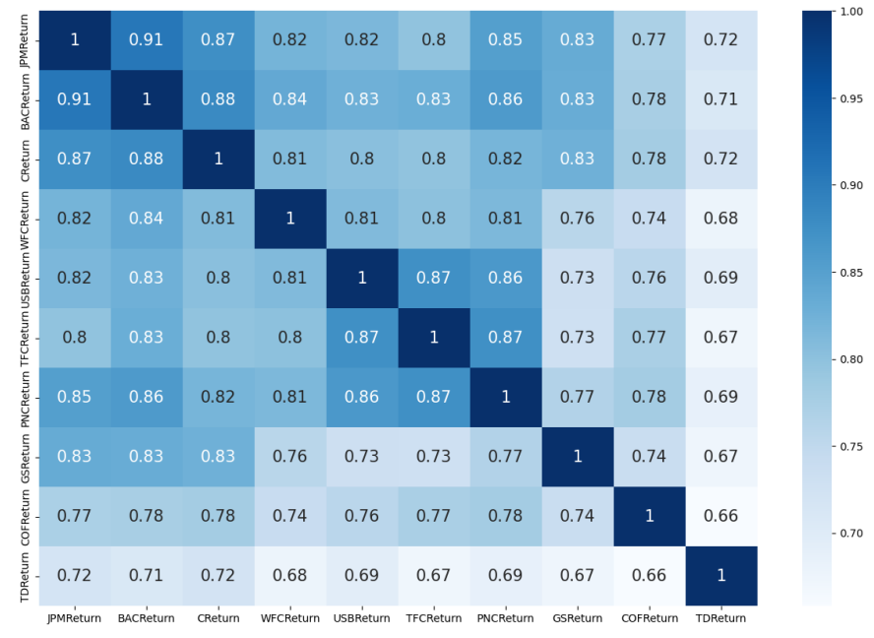
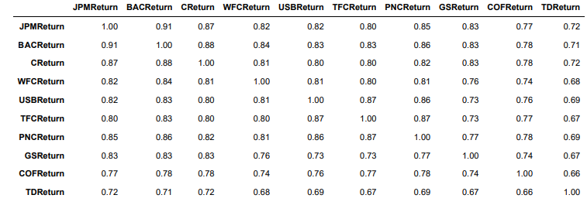
Exploratory Data Analysis
The correlation heatmap illustrates the dynamic interconnections between these finance industries.
There is a very strong to strong positive connection between all of the stock returns. The equities with the highest correlation are the returns from JP Morgan Chase and Bank of America (0.91) as well as Citi Bank and Bank of America (0.88).
The Bank of America's and JP Morgan Chase’s returns exhibit a strong correlation may be due to their shared institutional holder, JP Morgan Investment Management.

Slide 9
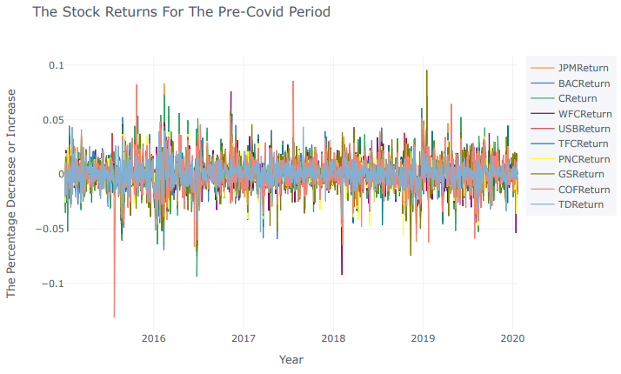
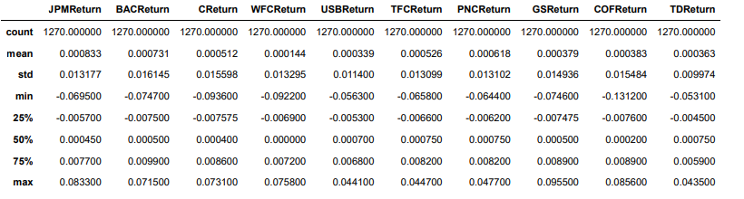
Exploratory Data Analysis
According to the time-series figure below, Goldman Sachs had the highest day return prior to Covid, at roughly 9.54%, and Capital One had the lowest return during this time, at roughly -13.12%.

Slide 10
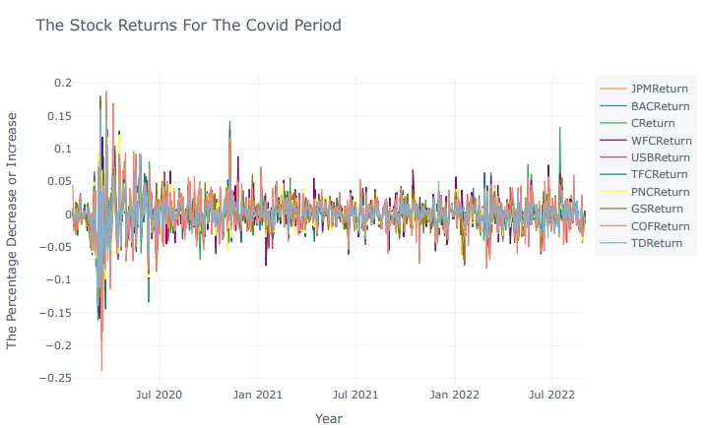
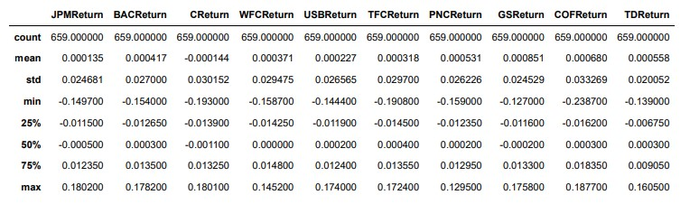
Exploratory Data Analysis
As can be seen in the time-series figure below, Capital One (COF Return) had the greatest day return during COVID at roughly 18.76%, and Capital One also had the lowest return at roughly -23.87%. Another sign of the stock's riskiness is Capital One's high standard deviation of 0.033.

Slide 11
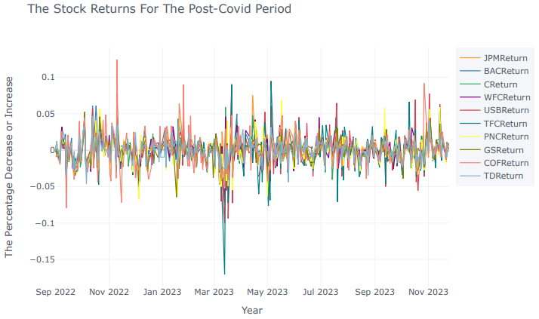
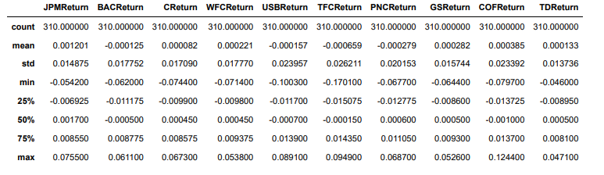
Exploratory Data Analysis
The time-series chart below shows that, after Covid, Capital One (COF Return) had the highest day return at roughly 11.78%, while Truist Financial (TFC Return) had the lowest return at roughly -16.99% during this timeframe. High volatility is also indicated by the TFC Return's high standard deviation of 0.026.

Slide 12
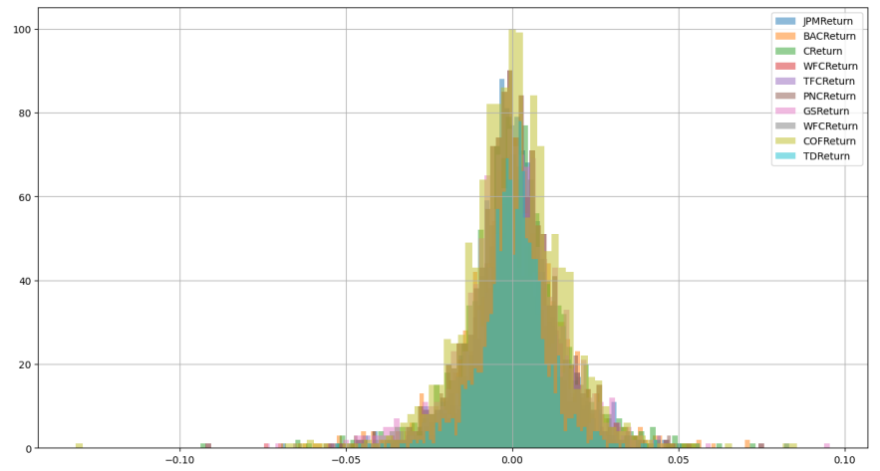
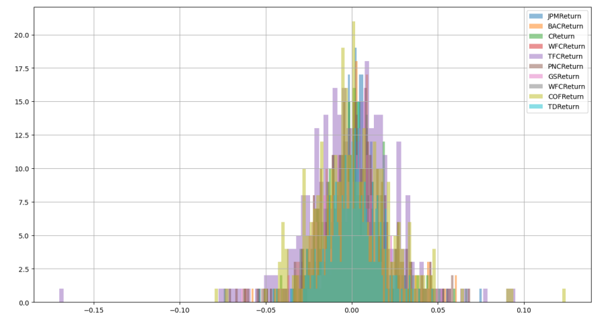
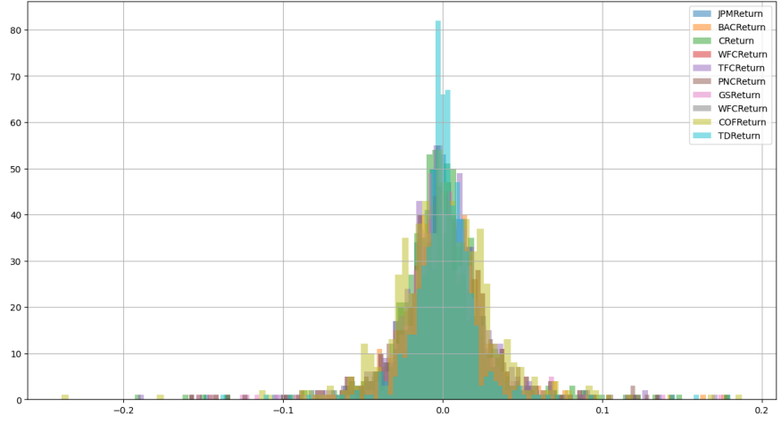
Exploratory Data Analysis
Volatility is the degree to which the price of a financial object i.e. stock, varies over time. High volatility suggests larger and more frequent price movements, low volatility indicates more consistent and predictable market fluctuations.
The most volatile stock before COVID-19 is Capital One (COF).
The most volatile stock during COVID-19 is Toronto-Dominion Bank (TD).
The most volatile stock after COVID-19 is Capital One.

Slide 13
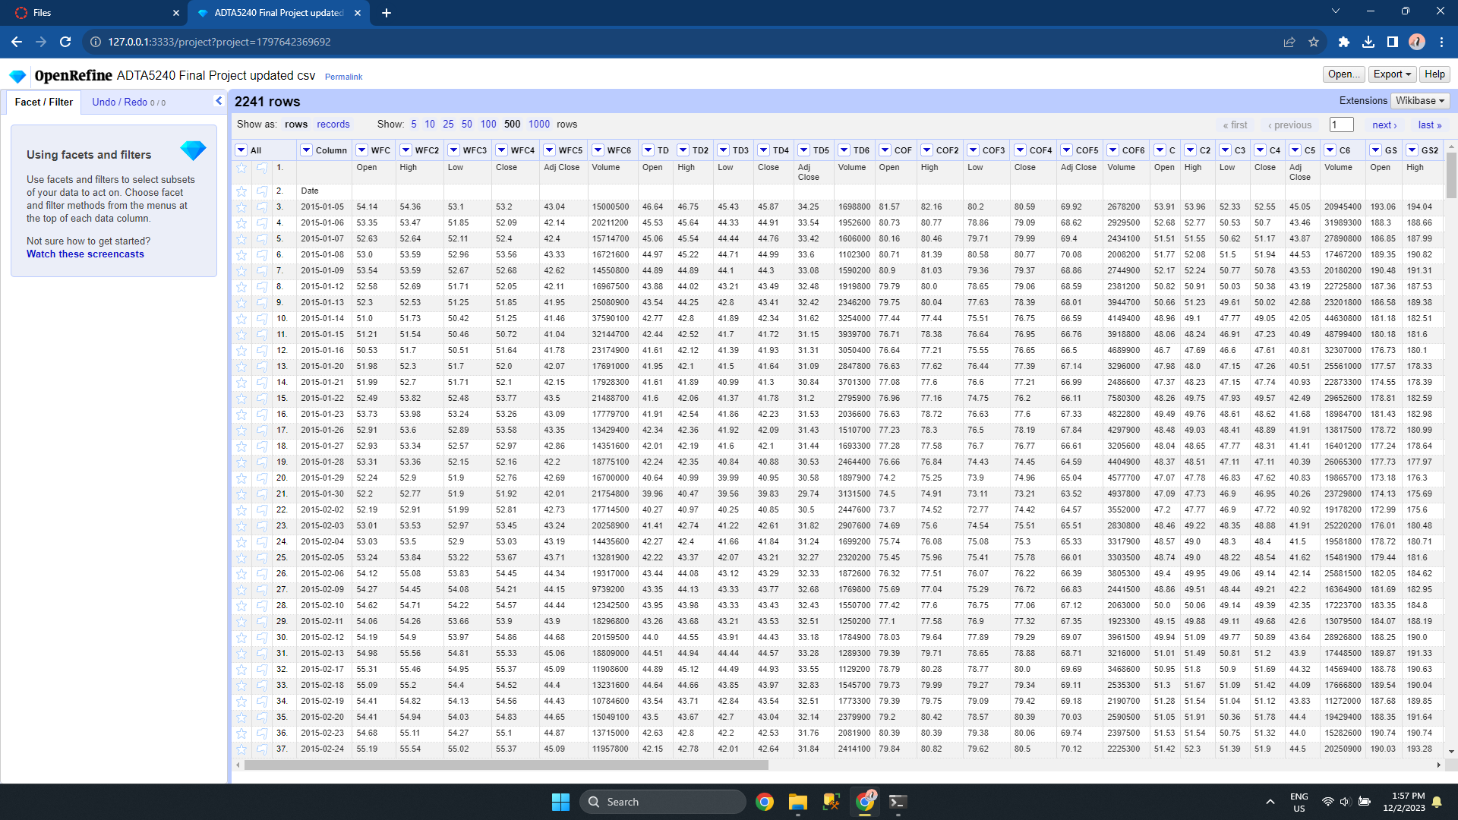
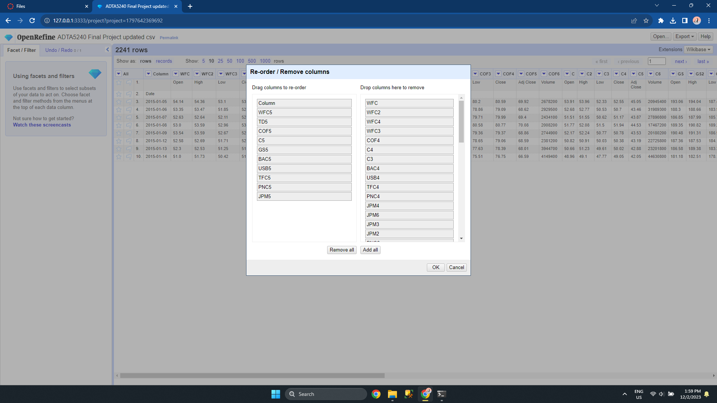
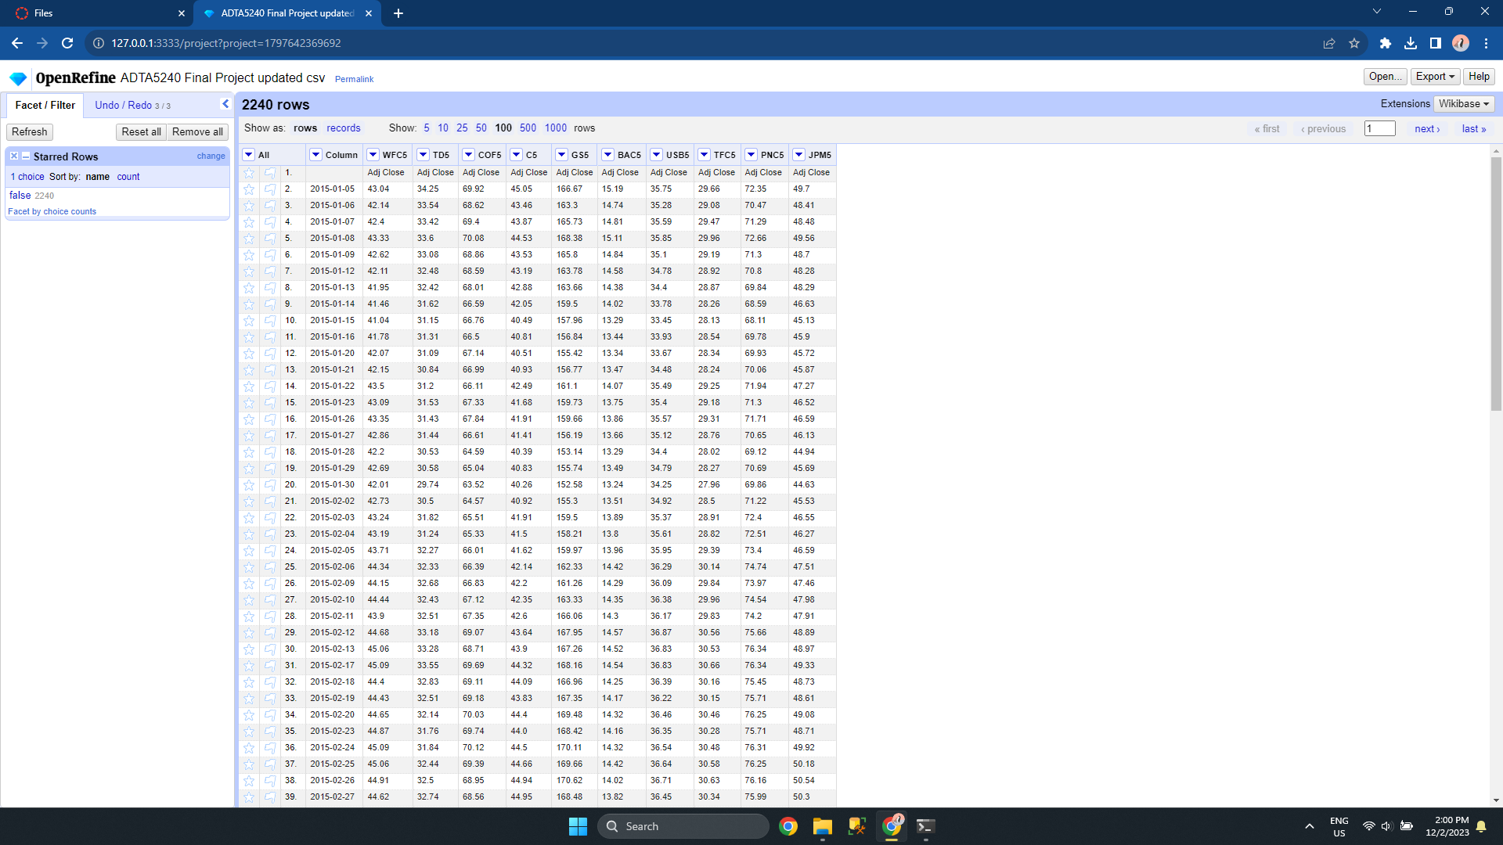
Open Refine
We used Open Refine to drop columns as a part of data cleaning.

Slide 14
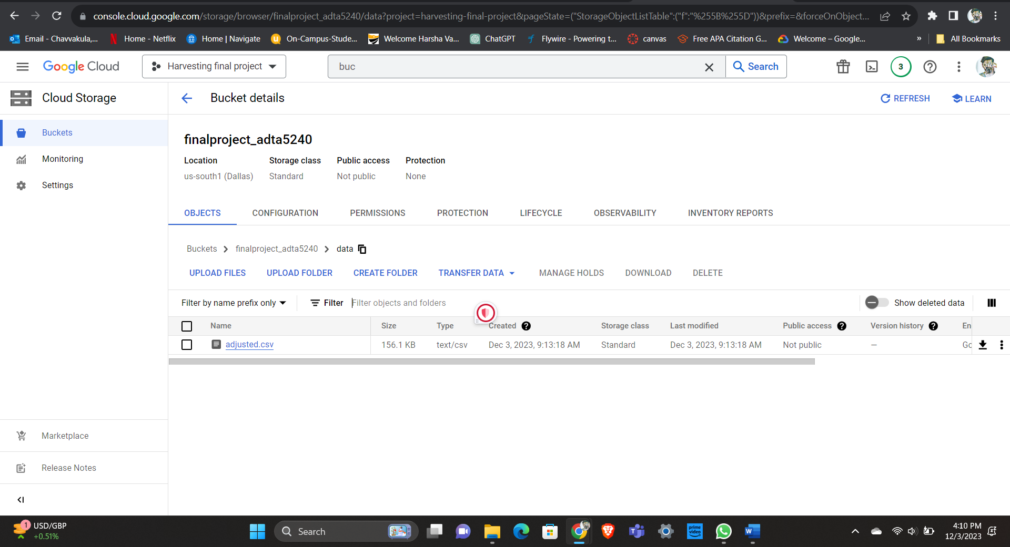
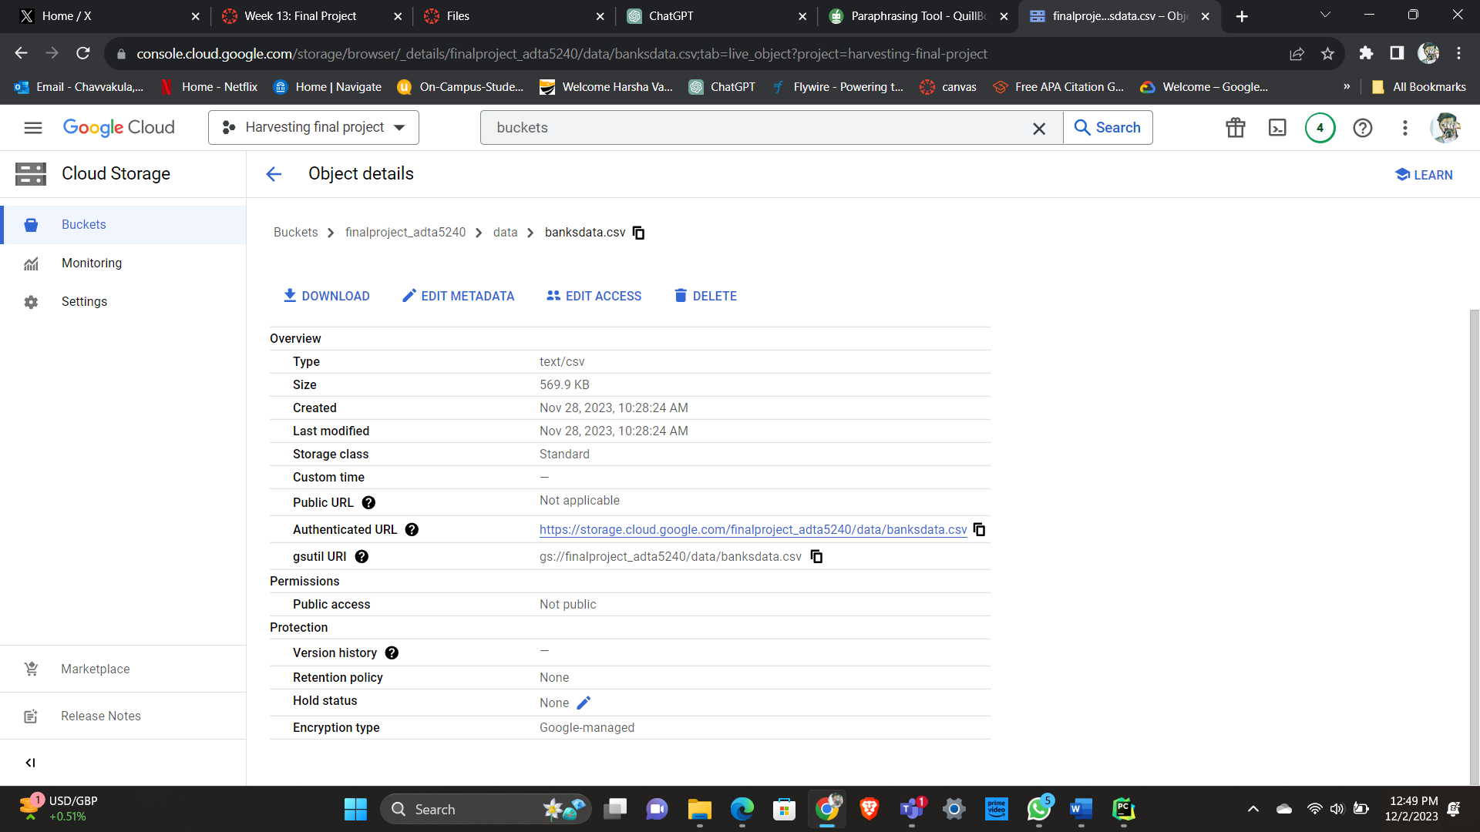
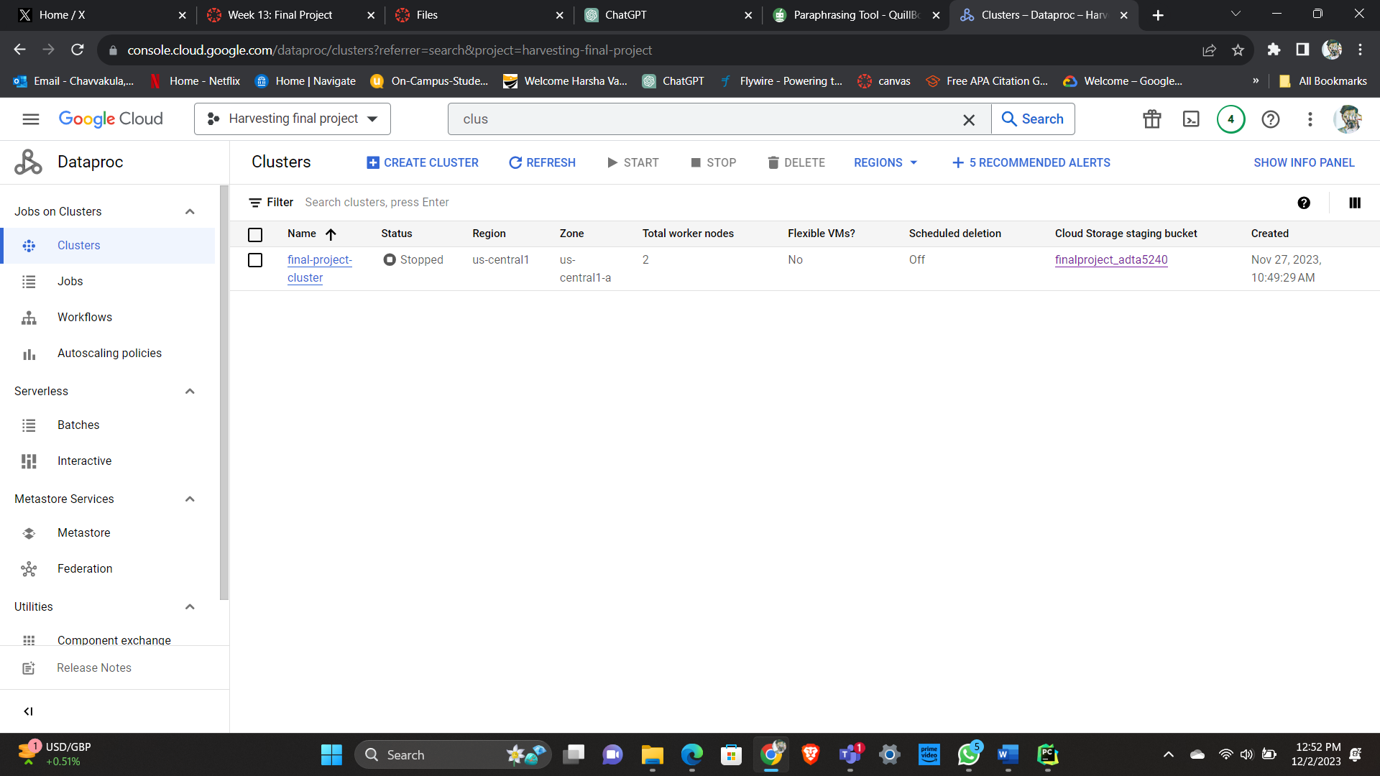
GCP
In our final project, we used the Google Cloud platform as a tool. We created a project in which we also created buckets to store data and then we uploaded our dataset. Then we created a cluster with virtual machines to run Linux.

Slide 15
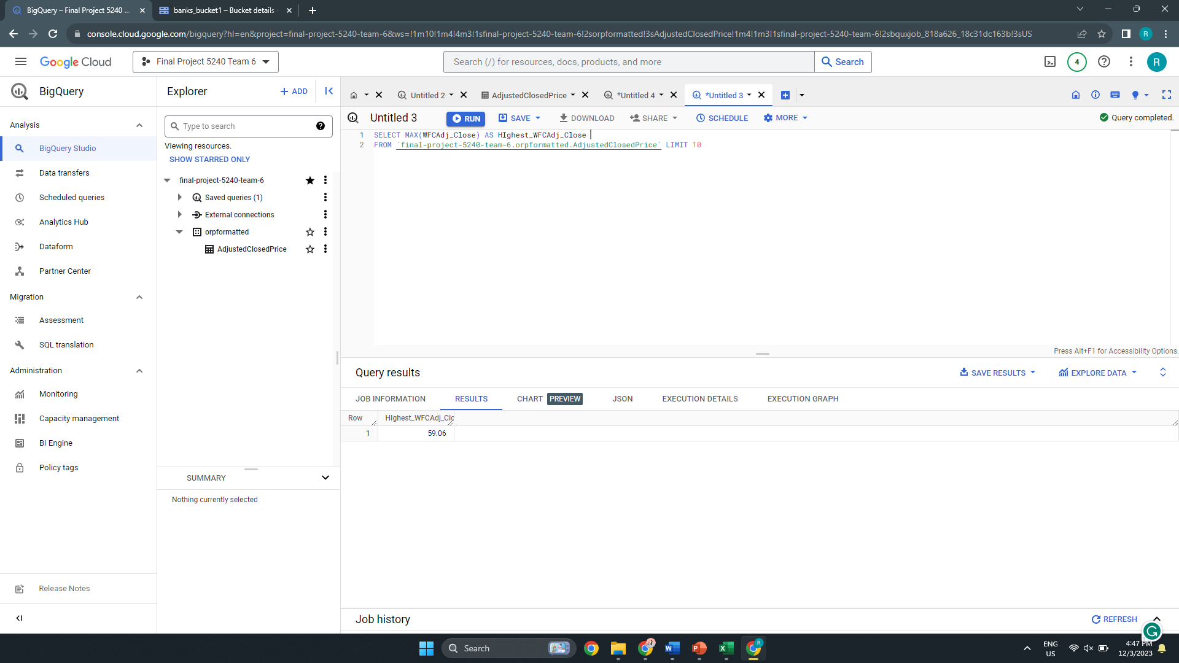
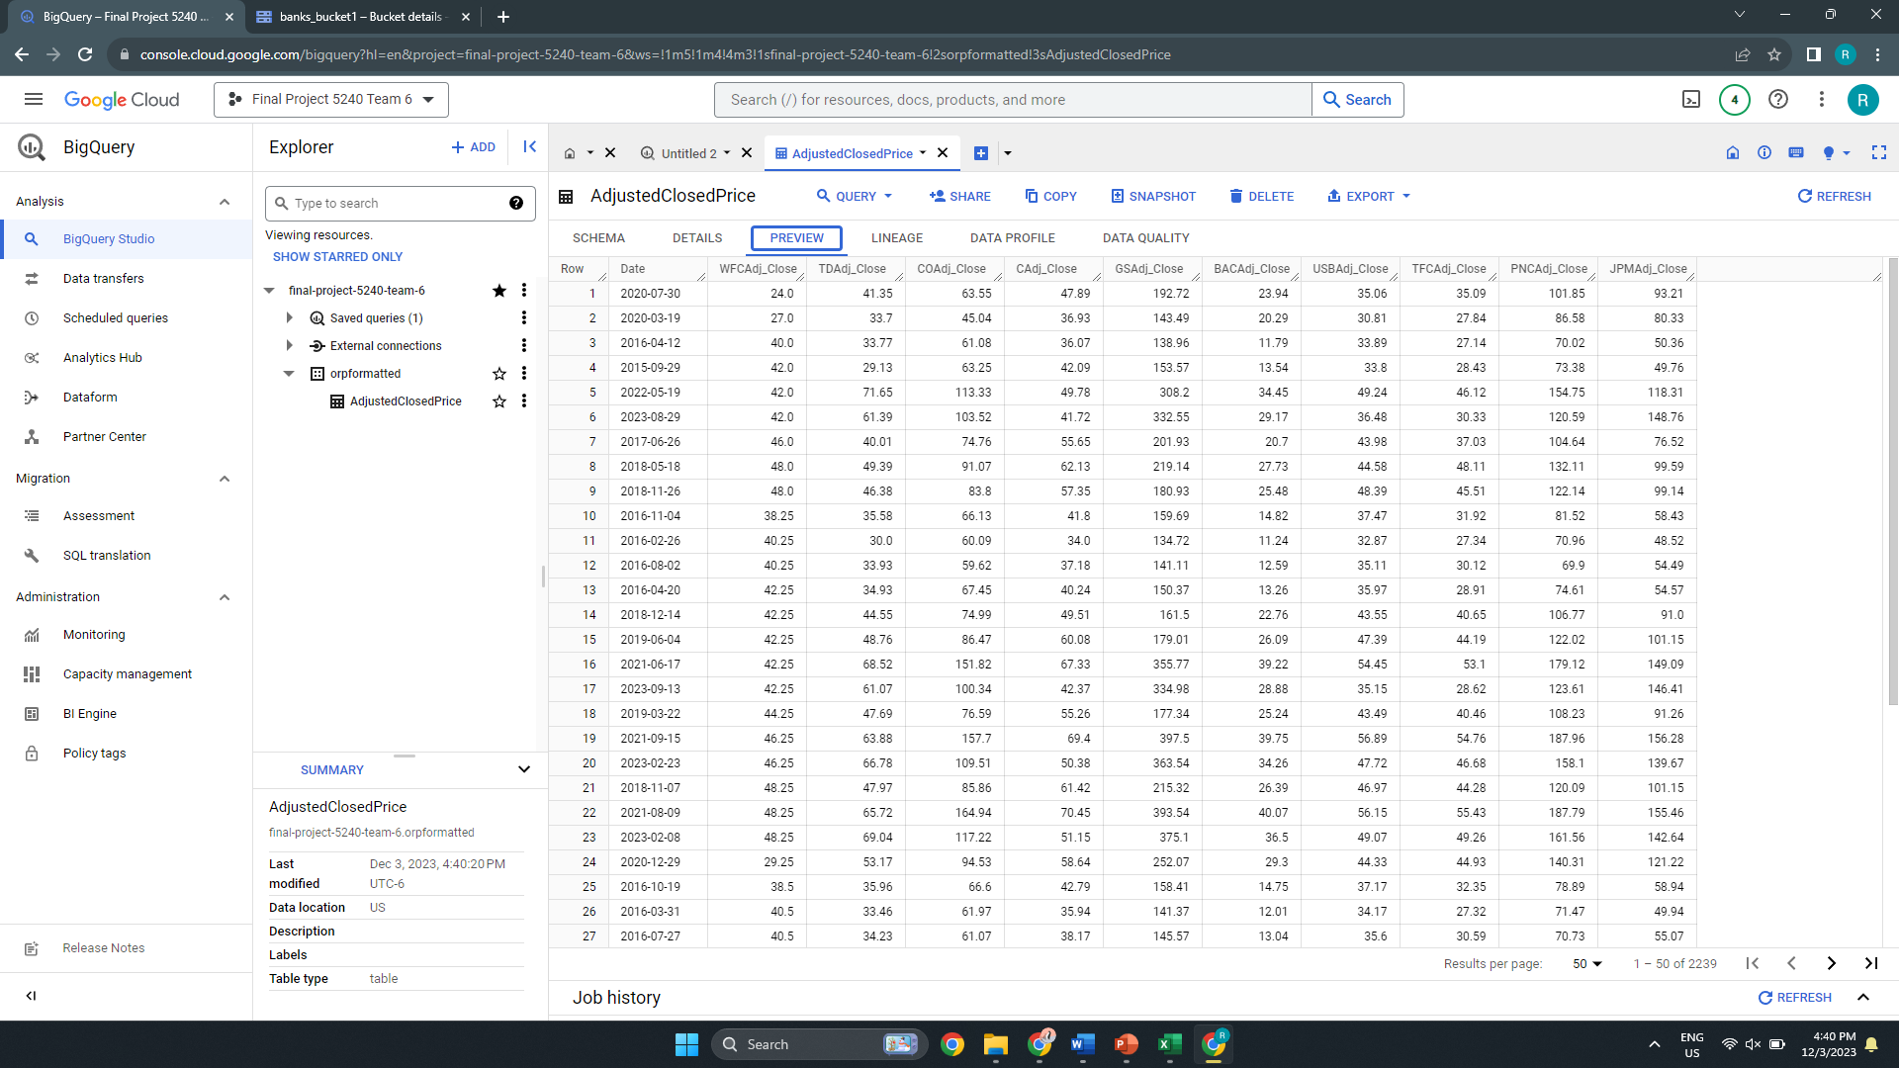
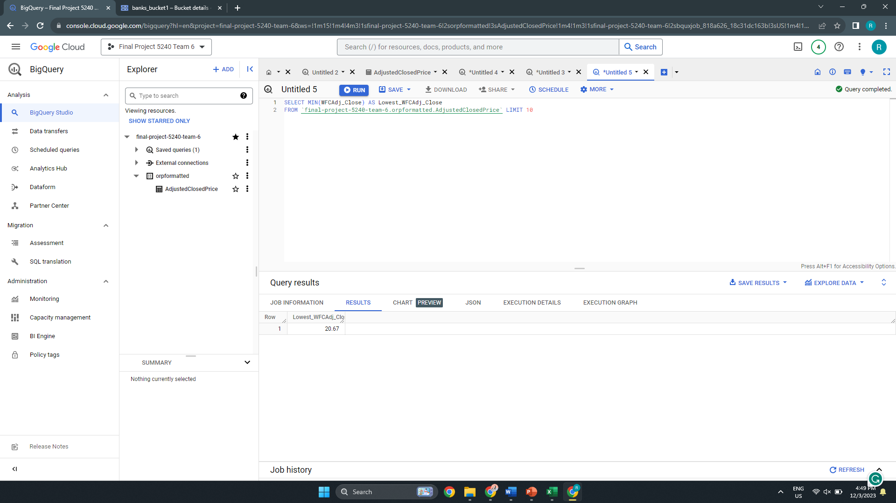
Big Query
We loaded the data from the storage bucket into the Big Query in GCP.
We also found out the highest and lowest stock prices for a bank with the help of a query.

Slide 16
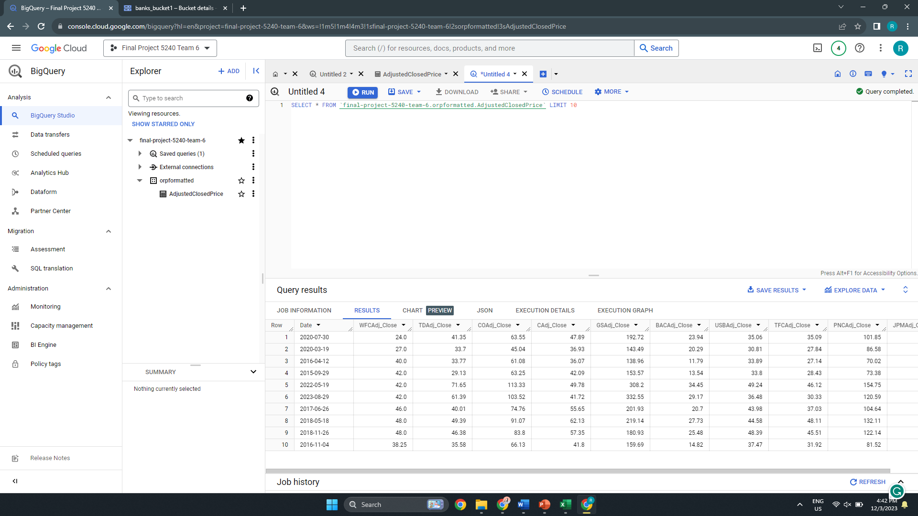

Big Query
We have retrieved the top 10 rows from our huge dataset using Big Query
Using the Big Query we have found the average of a particular bank stock price.
We have used the following queries.
SELECT MIN(WFCAdj_Close) AS Lowest_ WFCAdj_Close
FROM‘final-project-5240-team-6.orpformatted.AdjustedClosedPrice’ LIMIT 10
SELECT MAX(WFCAdj_Close) AS Highest_ WFCAdj_Close
FROM‘final-project-5240-team-6.orpformatted.AdjustedClosedPrice’ LIMIT 10
SELECT * FROM‘final-project-5240-team-6.orpformatted.AdjustedClosedPrice’ LIMIT 10

Slide 17
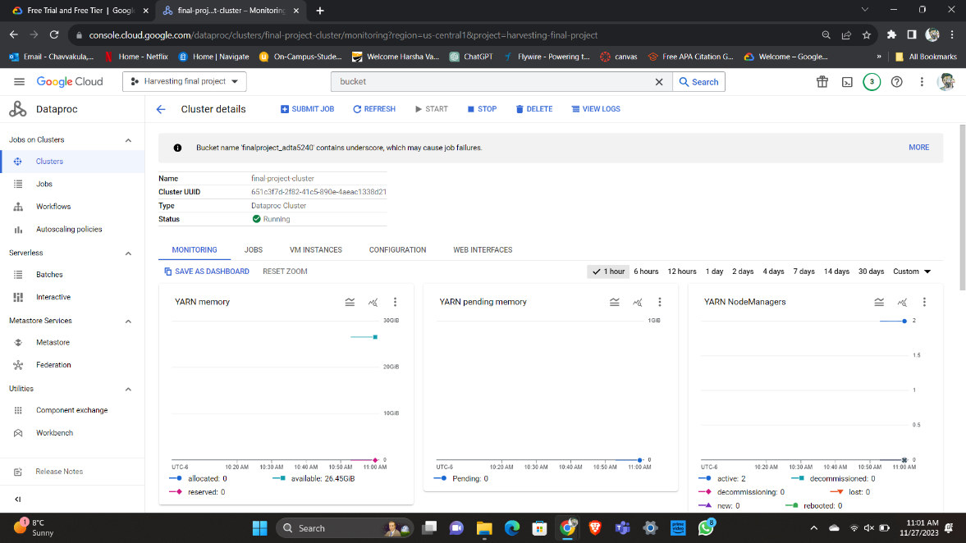
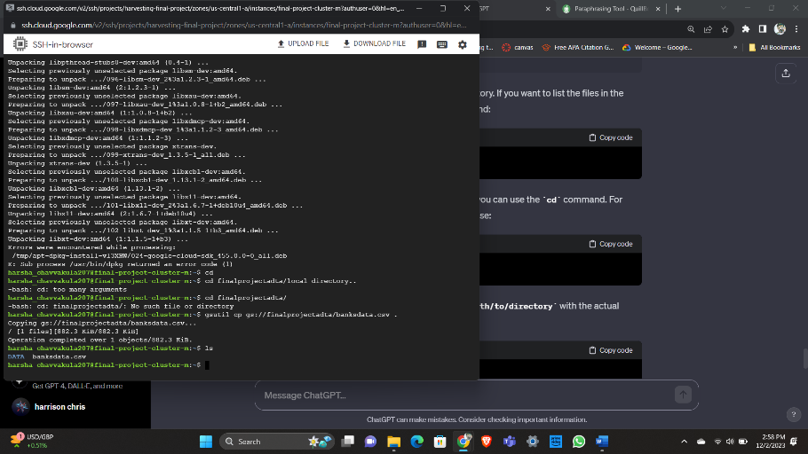
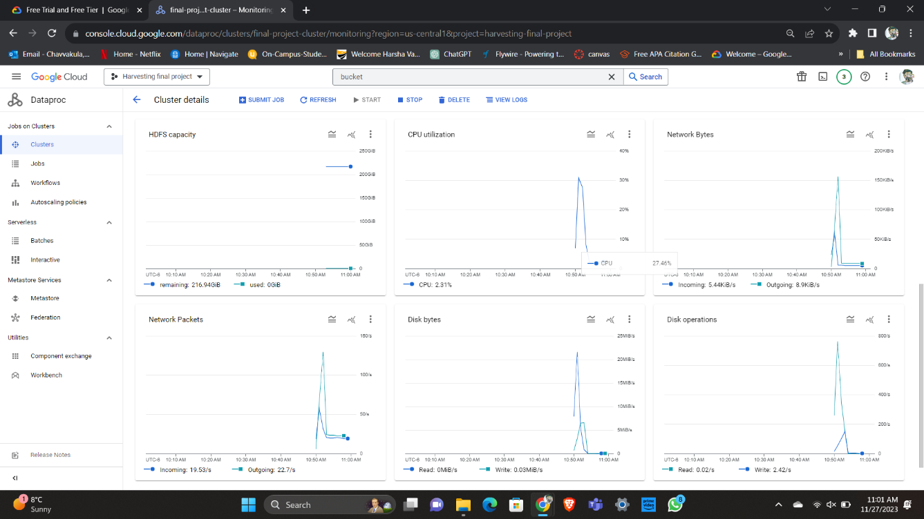
Linux
To get files from our path, we used a Linux command in the SSH terminal of the Manager node. We installed the "gsutil" tool, which performs several tasks like downloading, uploading, configuring access etc.
The dataset file was copied from our GCP bucket to the local directory with the command "gsutil cp gs://finalprojectadta/banksdata.csv.“
We used the command "ls" to verify that the file had been successfully downloaded.

Slide 18
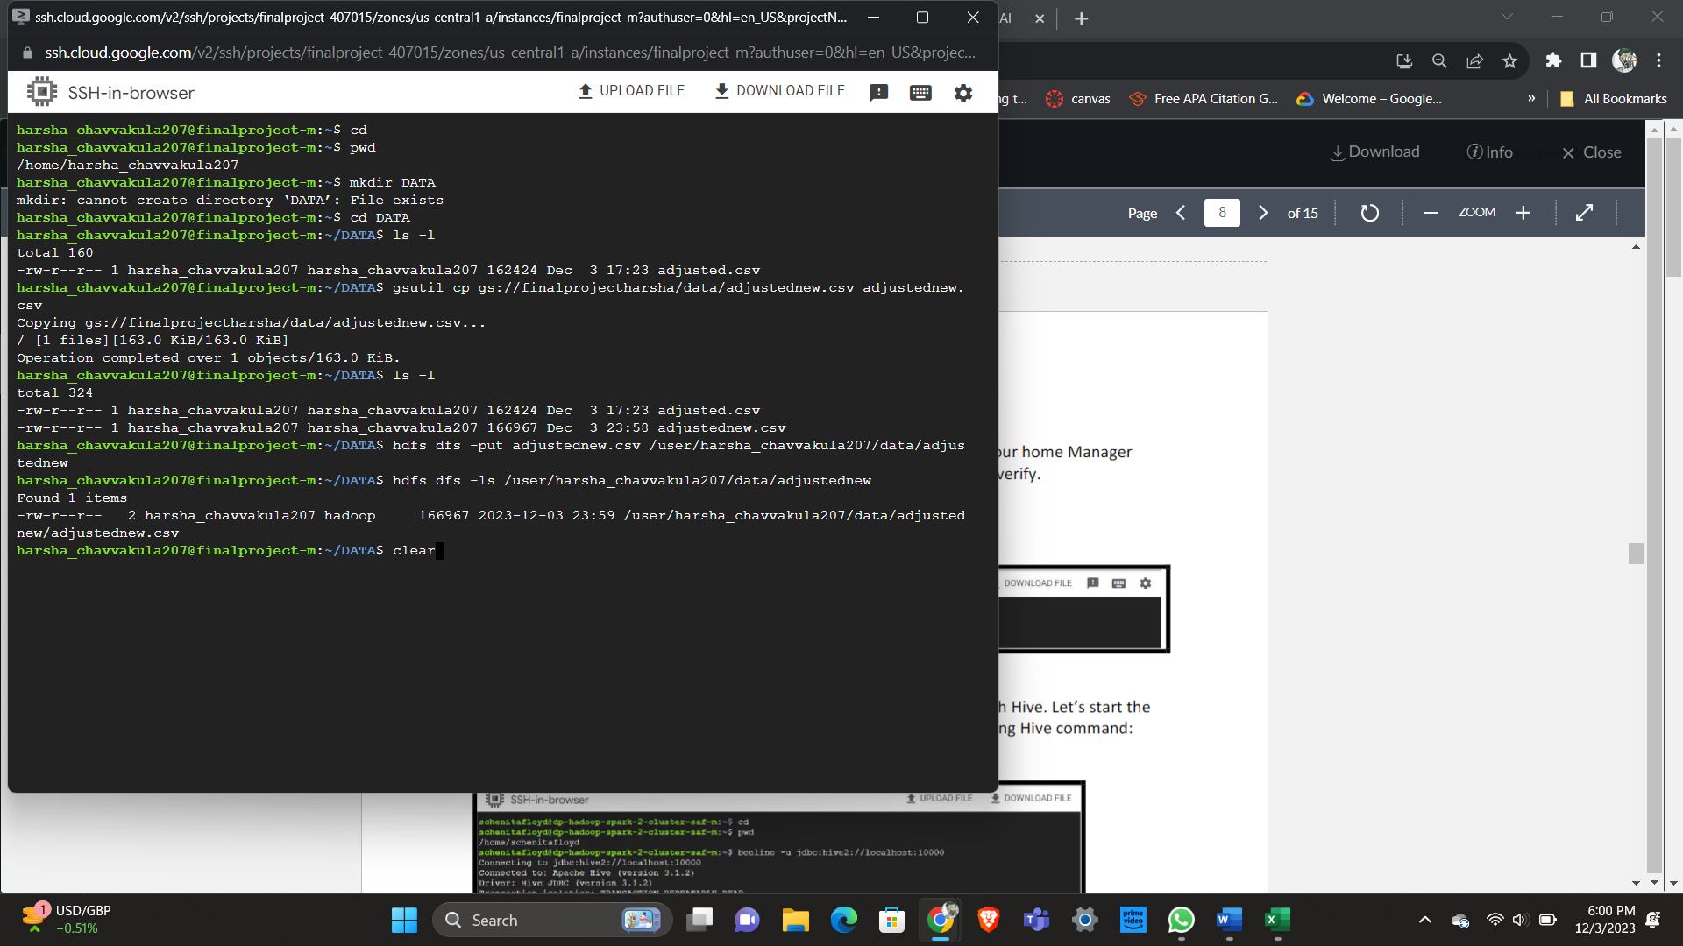
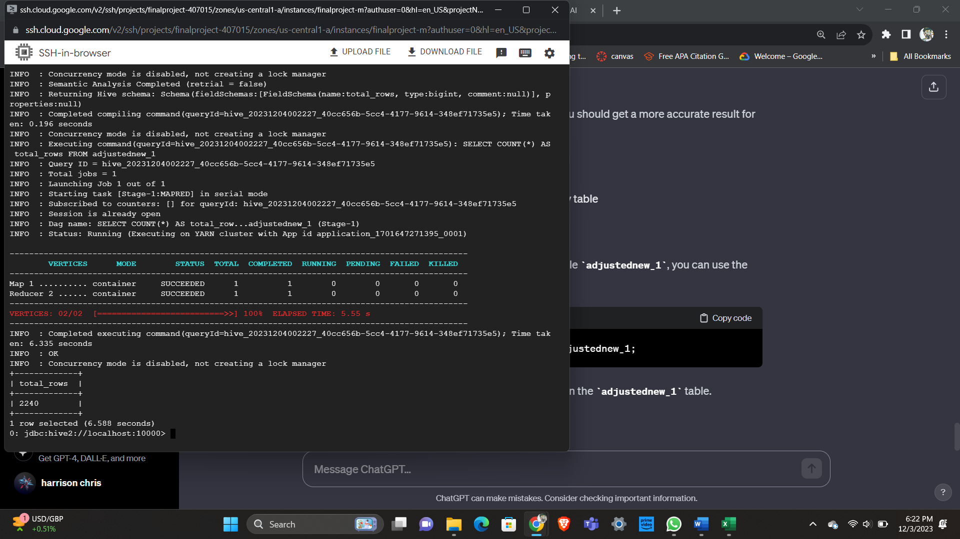
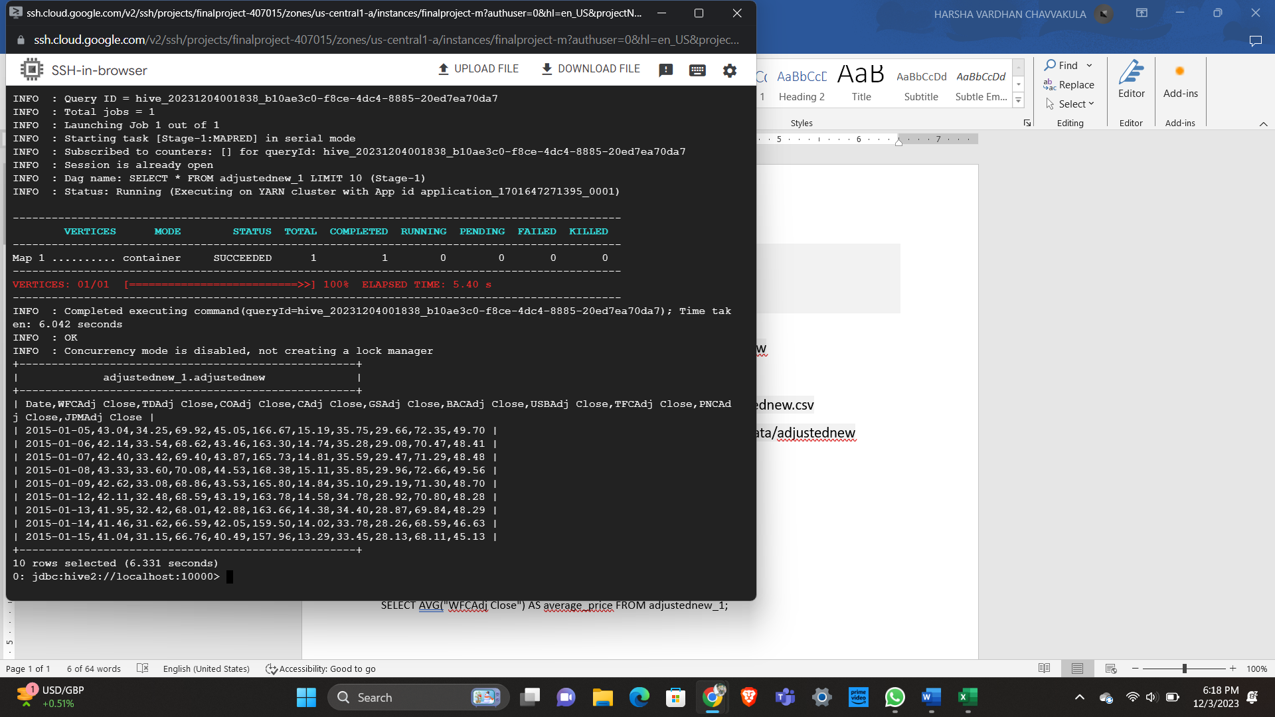
Hive
First we have changed the path directory from the storage bucket to the manager node.
We have used Hive to retrieve the first ten rows from our dataset using this query
SELECT * FROM adjustednew_1 LIMIT 10;
We have Hive to retrieve the number of rows we have in our dataset.
SELECT COUNT (*) AS total_rows FROM adjustednew_1

Slide 19
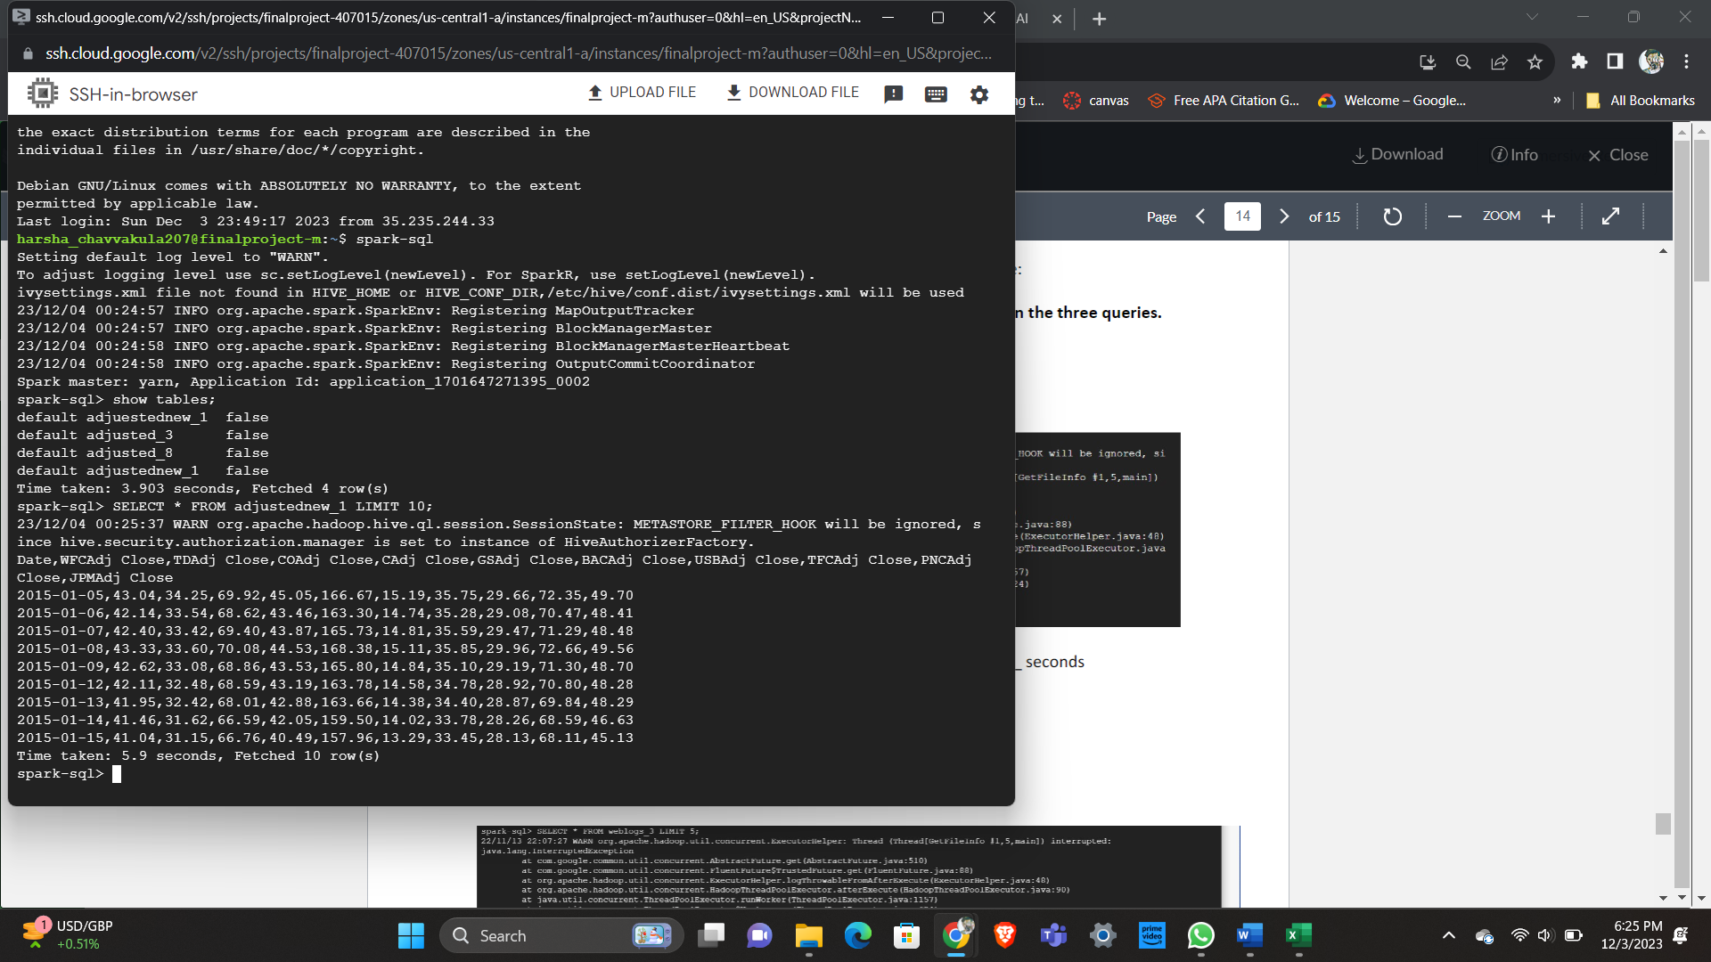
Spark
We have used Hive to retrieve the first ten rows from our dataset using this query
SELECT * FROM adjustednew_1 LIMIT 10;
There is a difference between the run time for both Hive and Spark as Hive took 6.3 sec to run and retrieve 10 rows while Spark only took 5.9 seconds.

Slide 20
Conclusion
In conclusion, the value of data-driven insights was demonstrated by our investigation, which examined the stock performances of the largest U.S. banks. Using detailed Exploratory Data Analysis (EDA), we discovered significant patterns and trends that allowed us to determine the effects of the pre-, during, and post-COVID periods. We processed data effectively by leveraging Google Cloud Platform (GCP) and Big Query to generate intelligent searches. Data retrieval was made easy by Spark and Hive's interaction. Our techniques, which range from cluster installation and Linux command usage to Open Refine data cleansing, demonstrate a thorough methodology that data scientists and analysts can use. These methods enable experts to obtain significant insights and promote well-informed financial analytics decision-making.

